Slide 1
Machine Learning
Presented By
Dr. Md. Zahid Hasan
Associate Professor, CSE, DIU

Slide 2
Machine Learning
Machine Learning involves making machine learn things like humans do.
It is set of techniques to make computers better at doing things.
Set of techniques to extract knowledge from available data and use that knowledge to make decisions.

Slide 3

What is ML?
Traditional programming involves us writing rules, expressed in a programming language, that act on data and give us answers.
Fig.1 : View of traditional programming

Slide 4
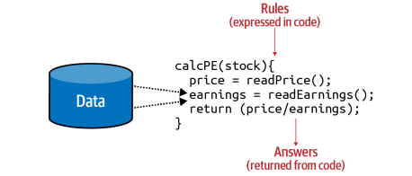
Example-A financial services scenario
Fig. 2: Code in a financial services scenario

Slide 5
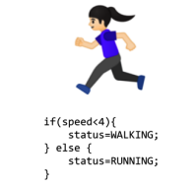
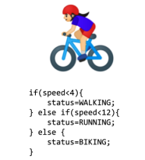

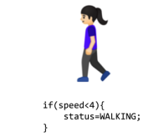
Limitations of Traditional Programming
Fig 1: Algorithm for
activity detection
Fig 2: Extending the
Algorithm for running
Fig 3: Extending the
algorithm for biking
Fig 4: How do we explain
a golfing algorithm?

Slide 6

Machine Learning
Fig. Changing the axes to get machine learning

Slide 7
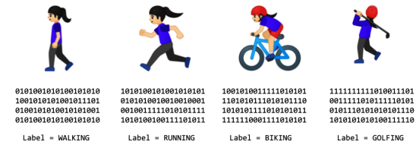
How would this work for our activity detection scenario?

Slide 8
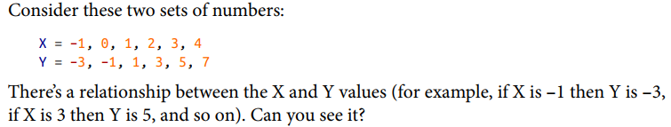

Getting Started with Machine Learning
The machine learning paradigm is one where you have data, that data is labeled, and you want to figure out the rules that match the data to the labels.
Pattern

Slide 9
Linear Regression Algorithm

Slide 10
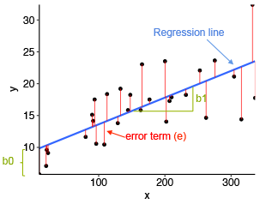
Linear Regression
Linear Regression is the supervised Machine Learning model in which the model finds the best fit linear line between the independent and dependent variable i.e it finds the linear relationship between the dependent and independent variable.
The core idea is to obtain a line that best fits the data. The best fit line is the one for which total prediction error (all data points) are as small as possible. Error is the distance between the point to the regression line.

Slide 11
Types of Linear Regression
Linear Regression is of two types: Simple and Multiple. Simple Linear Regression is where only one independent variable is present and the model has to find the linear relationship of it with the dependent variable
Whereas, In Multiple Linear Regression there are more than one independent variables for the model to find the relationship.

Slide 12

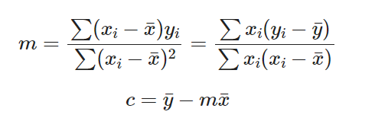
Equation of Simple Linear Regression
For a set of data points: (xi,yi), we can write the equation of the line as:
where yi is the predicted y-value, not the actual y-values of our points.
The gradient - m and y-intercept - c are called fit parameters. By using the method of linear regression (also called the method of least squares fitting), we can calculate the values for the two parameters and plot our line of best fit.
Calculate Slope and Intercept by using the formula

Slide 13
Dataset for Simple Linear Regression
 | Years Experience | Salary
1 | 1.1 | 39343.00
2 | 1.3 | 46205.00
3 | 1.5 | 37731.00
4 | 2.0 | 43525.00
5 | 2.2 | 39891.00

Slide 14

Multiple Linear Regression
Equation of Multiple Linear Regression, where bo is the intercept, b₁,b₂,b₃,b₄…,b_{n} are coefficients or slopes of the independent variables x₁,x₂,x₃,x₄…,x_{n} and y is the dependent variable.

Slide 15
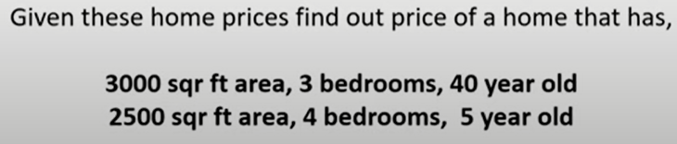
Dataset for Multi variable Regression
Area | Bedrooms | Age | Price
2600 | 3 | 20 | 550000
3000 | 4 | 15 | 565000
3200 | 3 | 18 | 610000
3600 | 3 | 30 | 595000
4000 | 5 | 8 | 760000

Slide 16
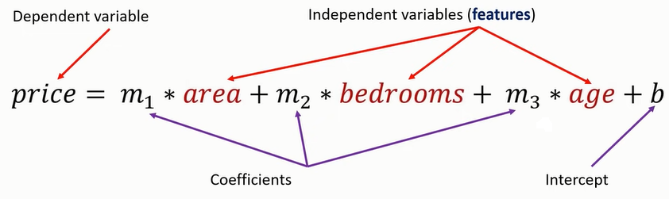
Coefficients and Intercept

Slide 17
Library Used in Program
import numpy as np
import pandas as pd
import matplotlib.pyplot as plt
from sklearn import linear_model
from sklearn.model_selection import train_test_split
import seaborn as sns
from sklearn import metrics
import matplotlib.pyplot as plt
from sklearn.model_selection import train_test_split

Slide 18
Data frame and Array
#Salary Dataset
# Generates data frame from csv file
df = pd.read_csv("F:/AI and Machine learning Book/Coding/Salary_Data.csv")
# Turning the columns into arrays
x = df["YearsExperience"].values
y = df["Salary"].values

Slide 19
Plot the data in Graph
# Plots the graph from the above data
plt.figure()
plt.grid(True)
plt.plot(x,y,'r.')

Slide 20
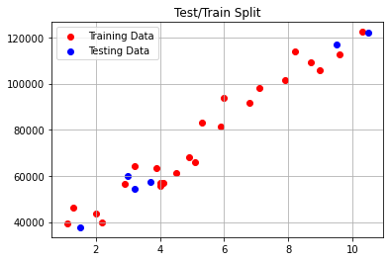
Calculate Gradient and Intercept
Independant variable or features
x = x.reshape(-1,1)
Dependant variable or labels
y = y.reshape(-1,1)
Seperates the data into test and training sets
X_train, X_test, y_train, y_test = train_test_split(x, y, test_size = 0.2)
Plotting the training and testing splits
plt.scatter(X_train, y_train, label = "Training Data", color = 'r')
plt.scatter(X_test, y_test, label = "Testing Data", color = 'b')
plt.legend()
plt.grid("True")
plt.title("Test/Train Split")
plt.show()

Slide 21
Define Linear Regression
# Defining our regressor
regressor = linear_model.LinearRegression()
# Train the regressor
fit = regressor.fit(X_train, y_train)

Slide 22
Gradient and Intercept
# Returns gradient and intercept
print("Gradient:",fit.coef_)
print("Intercept:",fit.intercept_)

Slide 23
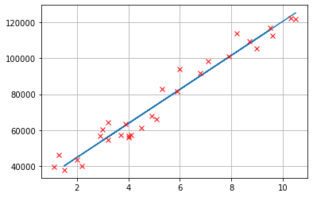
Predicted Lines
# Predicted values
y_pred = regressor.predict(X_test)
# Plot of the data with the line of best fit
plt.plot(X_test,y_pred)
plt.plot(x,y, "rx")
plt.grid(True)

Slide 24
Compare Predicted and Actual Value
#Converts predicted values and test values to a data frame
df = pd.DataFrame({"Predicted": y_pred[:,0], "Actual": y_test[:,0]})
 | Predicted | Actual
0 | 60820.440334 | 57189.0
1 | 54176.807620 | 60150.0
2 | 56074.988396 | 54445.0
3 | 115867.682821 | 116969.0
4 | 39940.451805 | 37731.0
5 | 125358.586698 | 121872.0

Slide 25
Determine Score of the model
# Determines a score for our model
score = regressor.score(X_test, y_test)
print(score)

Slide 26
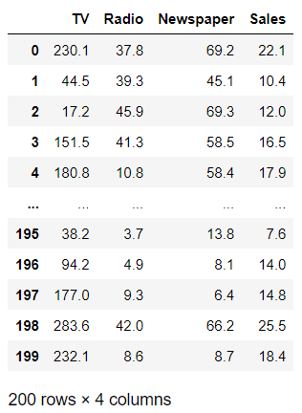
Multiple Linear Regression

Slide 27
Read Dataset
Converts advertising csv to a data frame
df = pd.read_csv("F:/AI and Machine learning Book/Coding/advertising.csv")
df

Slide 28
Drop Column and Split Dataset
In the following code cell, we can see that Sales is dropped from df so that only independent variables x remain. Now we specify Sales as y since it is the dependent variable and we need to reshape it because it consists of only one column
Independent variables
X = df.drop("Sales",axis=1)
Dependent variable
y = df["Sales"].values.reshape(-1,1)
Splitting into test and training data
X_train, X_test, y_train, y_test = train_test_split(X,y,test_size=0.2)

Slide 29
Use Linear Regression
Defining regressor
regressor = linear_model.LinearRegression()
Training our regressor
fit = regressor.fit(X_train,y_train)
Predicting values
y_pred = fit.predict(X_test)

Slide 30
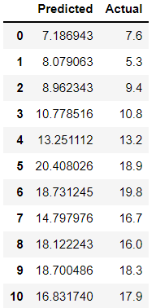
Compare predicted and Actual value
Comparing predicted against actual values
df = pd.DataFrame({"Predicted": y_pred[:,0], "Actual": y_test[:,0]})
df

Slide 31
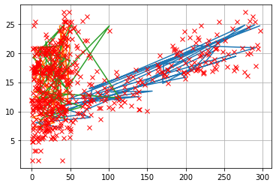
Plot with Best fitted line
Plot of the data with the line of best fit
plt.plot(X_test,y_pred)
plt.plot(X,y, "rx")
plt.grid(True)

Slide 32
Score of the model
# Scoring our regressor
fit.score(X_test,y_test)
Accuracy=0.9291555806063022

Slide 33
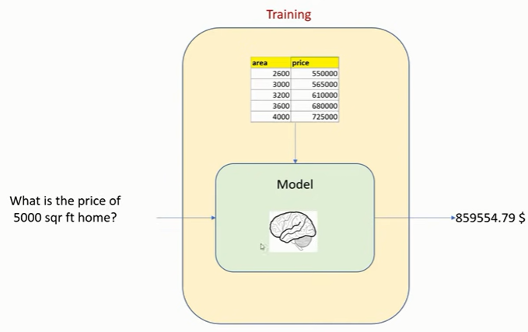
Save and Load the Model

Slide 34
Save the model in a file
import pickle
filename = '/content/drive/MyDrive/Summer 2022/MSC/Linear_Regression/finalized_model.sav‘
pickle.dump(fit, open(filename, 'wb'))

Slide 35
Load the saved model
loaded_model = pickle.load(open(filename, 'rb'))
loaded_model.coef_
loaded_model.intercept_
loaded_model.predict([[5000]])

Slide 36
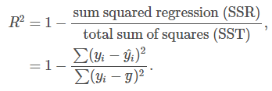
R^2 Square value
from sklearn import metrics
print('Model R^2 Square value', metrics.r2_score(y_test, y_pred))
Model R^2 Square value 0.9291555806063022
The Goal of Linear Regression is to find out the best hypothesis which maximize the R^2 Square value.
The coefficient of determination, or R^2, is a measure that provides information about the goodness of fit of a model. In the context of regression it is a statistical measure of how well the regression line approximates the actual data. It is therefore important when a statistical model is used either to predict future outcomes or in the testing of hypotheses.

Slide 37
Input x=[1,2,3,4,5]
Output y=[5,7,9,11,13]
Derive an Equation (Prediction Function)
y=2x+3
Area=[2600,3000,3200,3600,4000]
Price= [550K, 565k, 610k, 680k, 725k]
Derive Equation (Prediction Function)
Price= 135.78*Area+180616.43

Slide 38
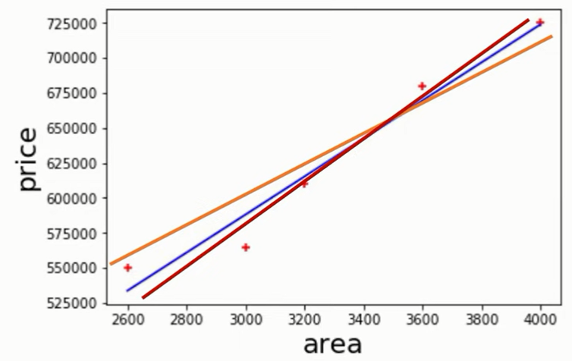
Price vs Area using Linear Regression (Multiple Best Fit Line)

Slide 39
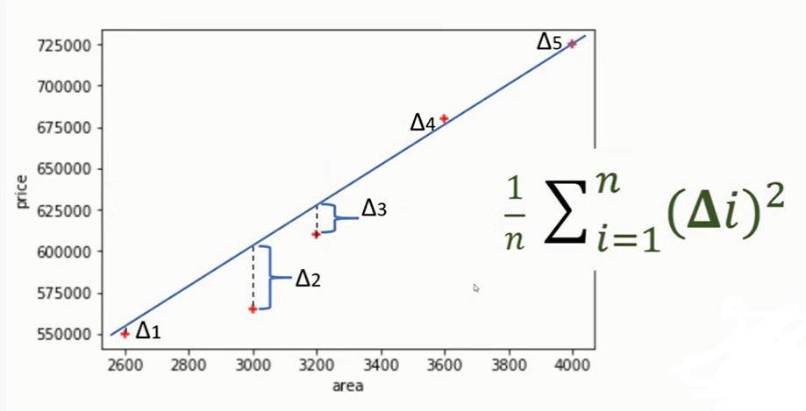
Calculate error from Data Points

Slide 40
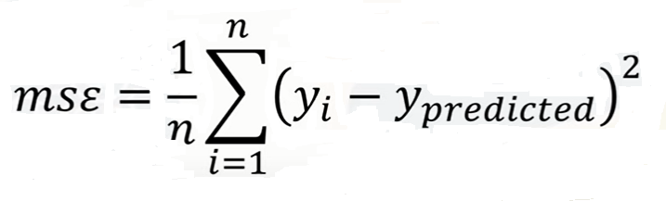
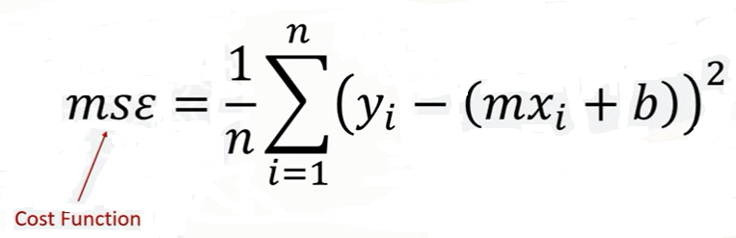
Mean Squared Error (MSE)

Slide 41
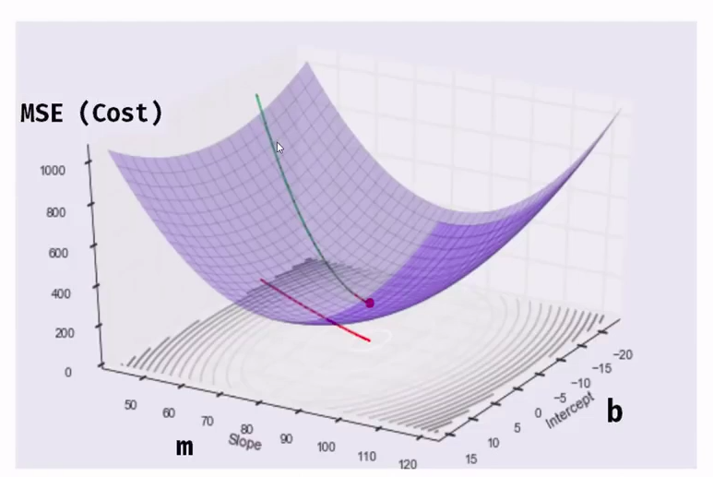
Gradient Descent Algorithm

Slide 42
Gradient Search

Slide 43
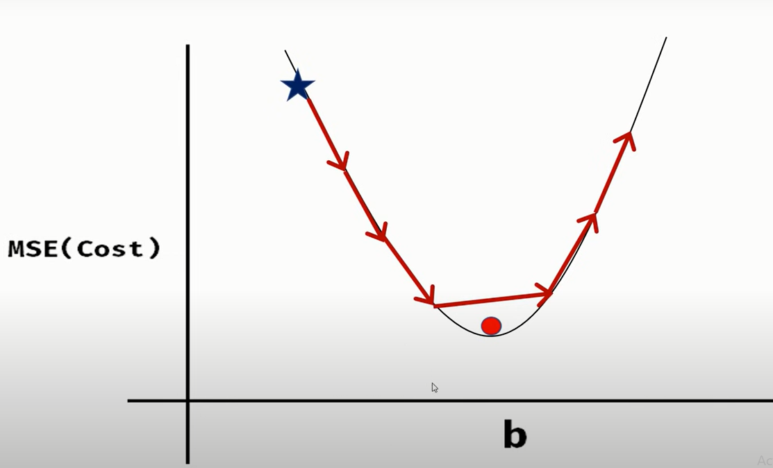
Fixed Size Step to reach global Minima

Slide 44
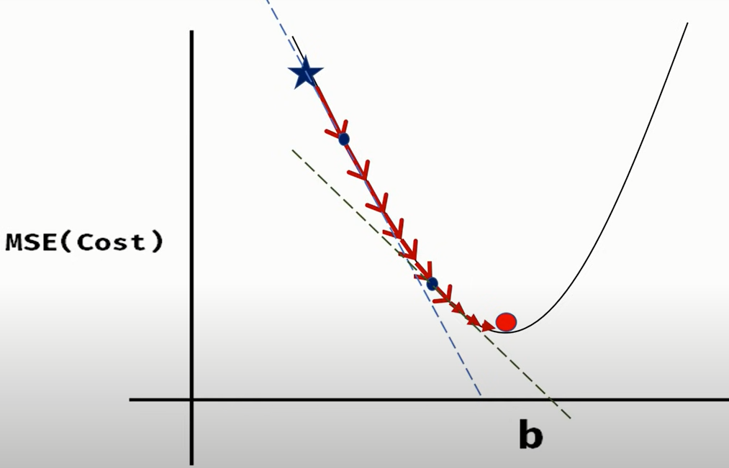
Small steps (learning rate)

Slide 45
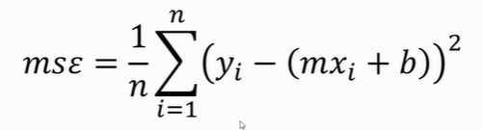
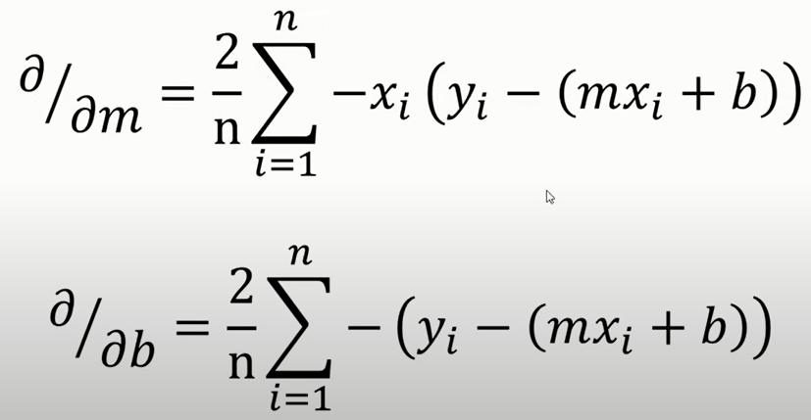
Partial Derivative of Mean Square Error

Slide 46
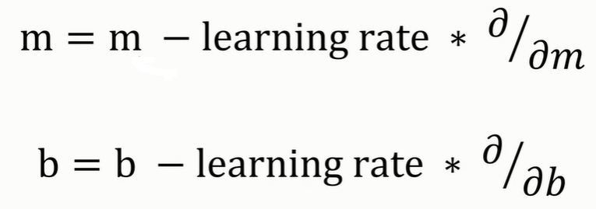
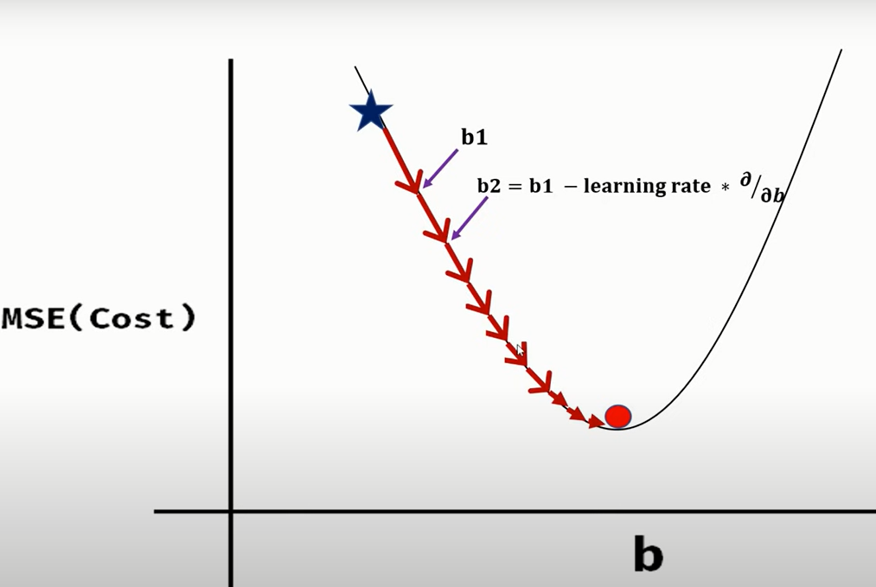
Updating b using Partial Derivative

Slide 47

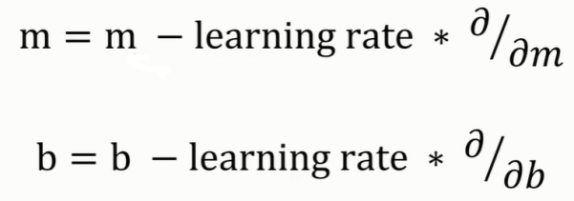
Implementation
import numpy as np
import matplotlib.pyplot as plt
def gradient_descent(x,y):
m_curr = b_curr = 0
rate = 0.01
n = len(x)
plt.scatter(x,y,color='red',marker='+',linewidth='5')
for i in range(10000):
y_predicted = m_curr * x + b_curr
plt.plot(x,y_predicted,color='green')
md = -(2/n)*sum(x*(y-y_predicted))
yd = -(2/n)*sum(y-y_predicted)
m_curr = m_curr - rate * md
b_curr = b_curr - rate * yd

Slide 48
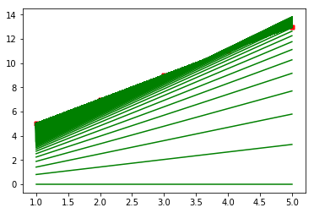
Plotting Gradient Descent
x = np.array([1,2,3,4,5])
y = np.array([5,7,9,11,13])
gradient_descent(x,y)

